Slide 1
Data science
And Sweet Factory
Abdulrahman alshehri
EDA MTA

Slide 2
Analytical approach
Target market | Commuter stations
Commuter using the Metropolitan transportation authority (MTA) system Very likely to buy Dessert at the exit from the station | Maximum advertising exposure High entry rate in the afternoon or evening

Slide 3
Analytical approach
Data Analysis | Outcome
Analyzed MTA turnstile data from October to December 2019 Afternoon and evening hours: 4 PM to 8 PM Total amount of commuter traffic by station Visualize data analysis | Increase user base with posted advertisements in high-traffic MTA stations Encourage purchases through push notifications with discounts for sweet factory shops at peak hours

Slide 4
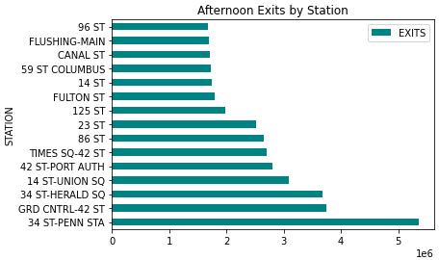
Busiest Commuter Stations

Slide 5
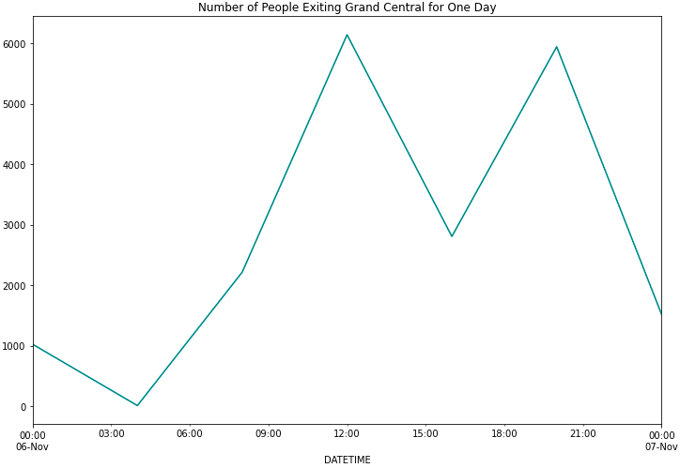
Daily Cycle of exits

Slide 6
conclusion
It is necessary to target the busiest stations, publish discounts, motivate them and attract them with memberships in which they can get points, and in cooperation with international companies, they can be exchanged and advertisements be posted next to the available tourism offices.

